Slide 1

Stable Diffusion
Git: https://githuddb.com/CompVis/latent-diffusion

Slide 2
Paper Contents
1
2
3
4
5
Abstract
Introduction
Methods
Experiments
Conclusion

Slide 3
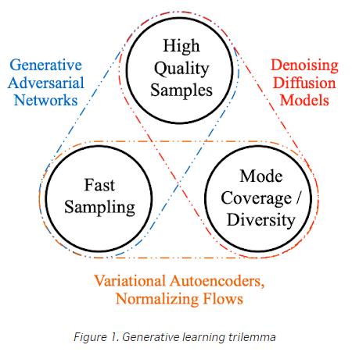
Background

Slide 4
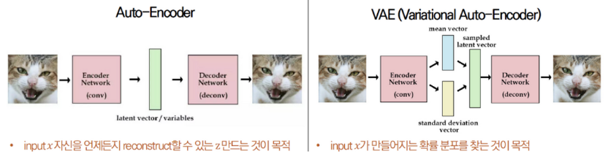
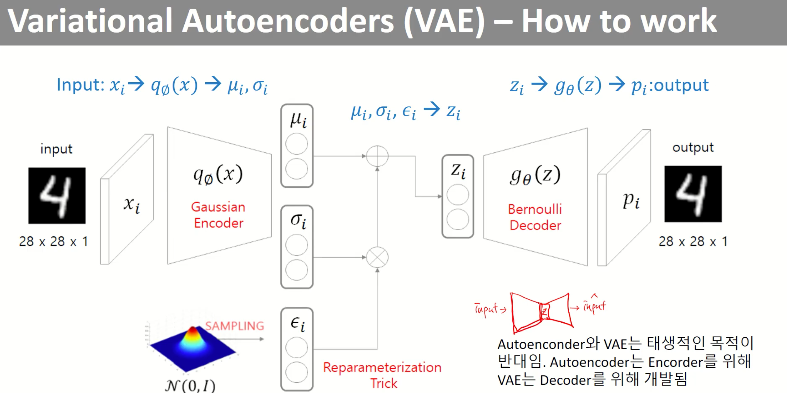
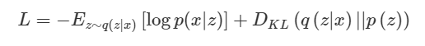
Background – VAE
Notes:
P(x)는 표준 정규분포에서 샘플
Posterior => p(z|x)
prior => p(x)

Slide 5
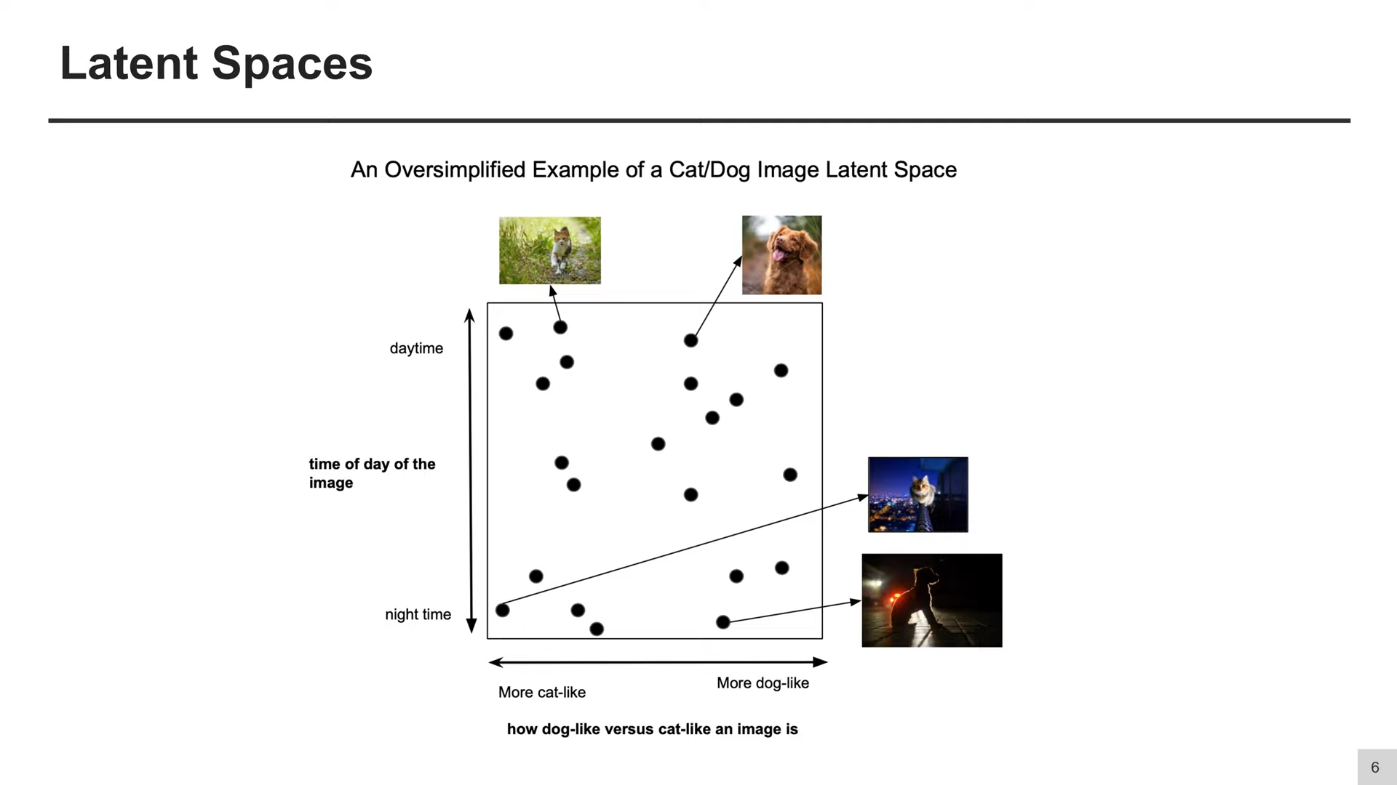
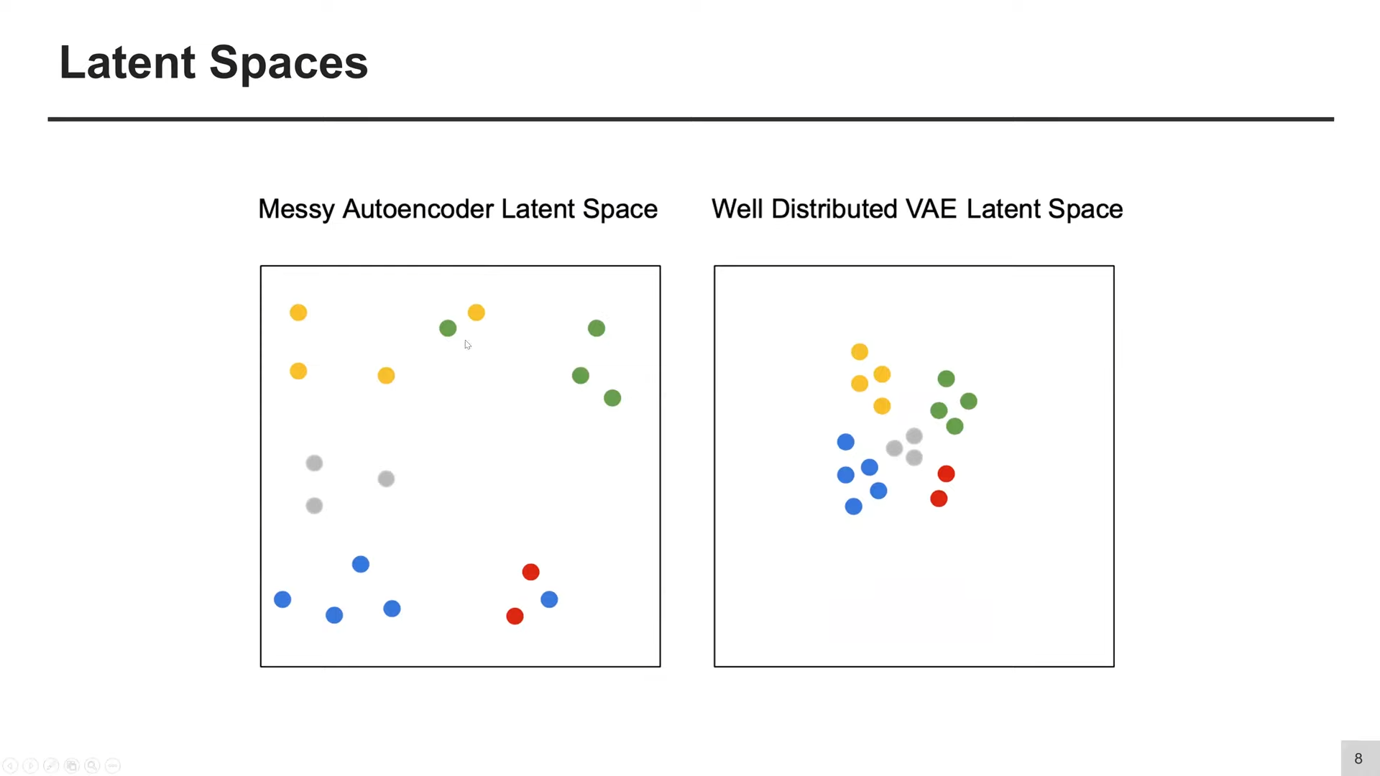
Background – VAE
Notes:
슬라이드 출처: https://www.youtube.com/watch?v=RKk17yjc1b8&list=LL&index=30

Slide 6
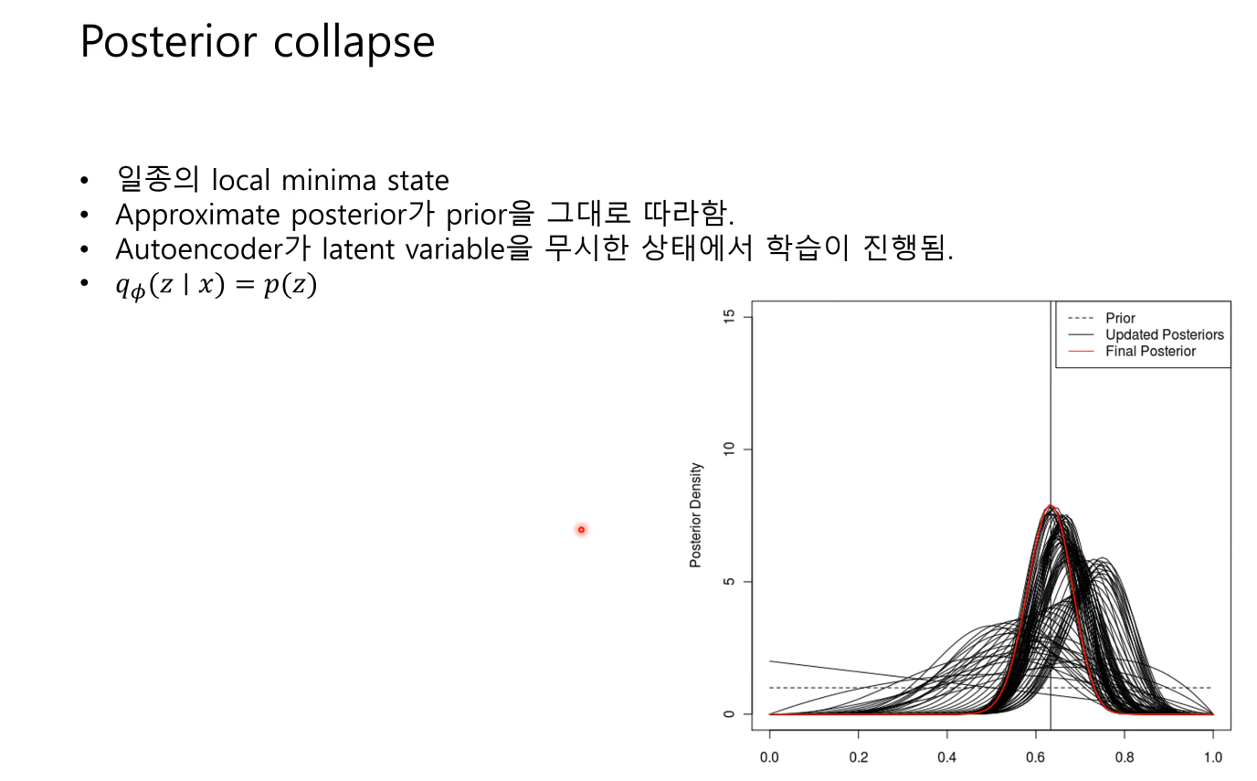
Background – VQ-VAE
Notes:
슬라이드 출처: https://www.youtube.com/watch?v=RKk17yjc1b8&list=LL&index=30

Slide 7
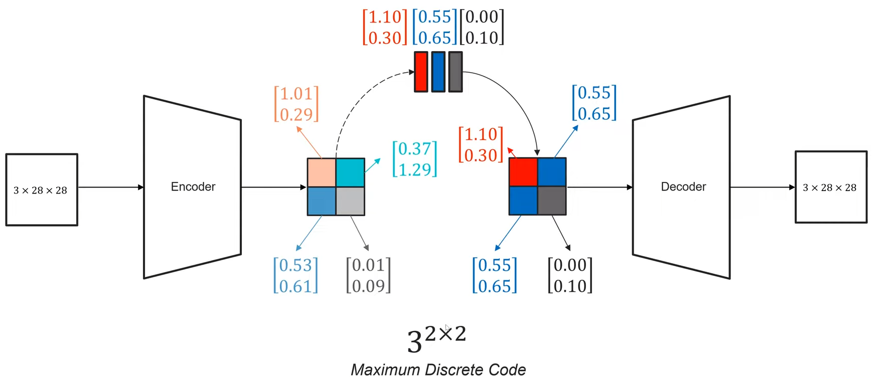
Background – VQ-VAE
Notes:
슬라이드 출처: https://www.youtube.com/watch?v=RKk17yjc1b8&list=LL&index=30

Slide 8
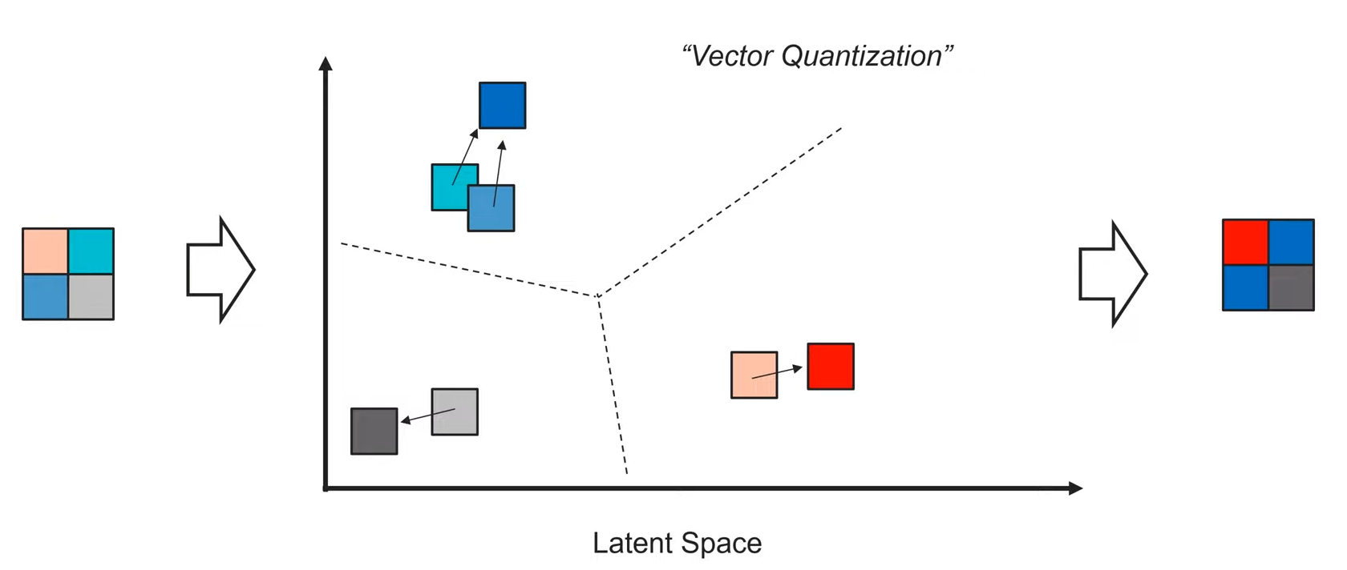
Background – VQ-VAE
Notes:
슬라이드 출처: https://www.youtube.com/watch?v=RKk17yjc1b8&list=LL&index=30

Slide 9
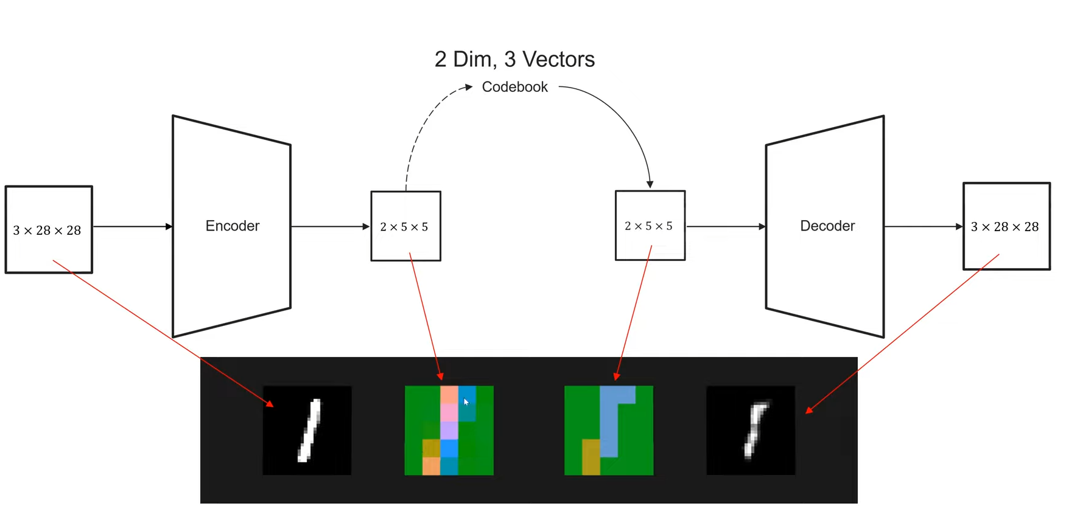
Background – VQ-VAE
Notes:
슬라이드 출처: https://www.youtube.com/watch?v=RKk17yjc1b8&list=LL&index=30

Slide 10
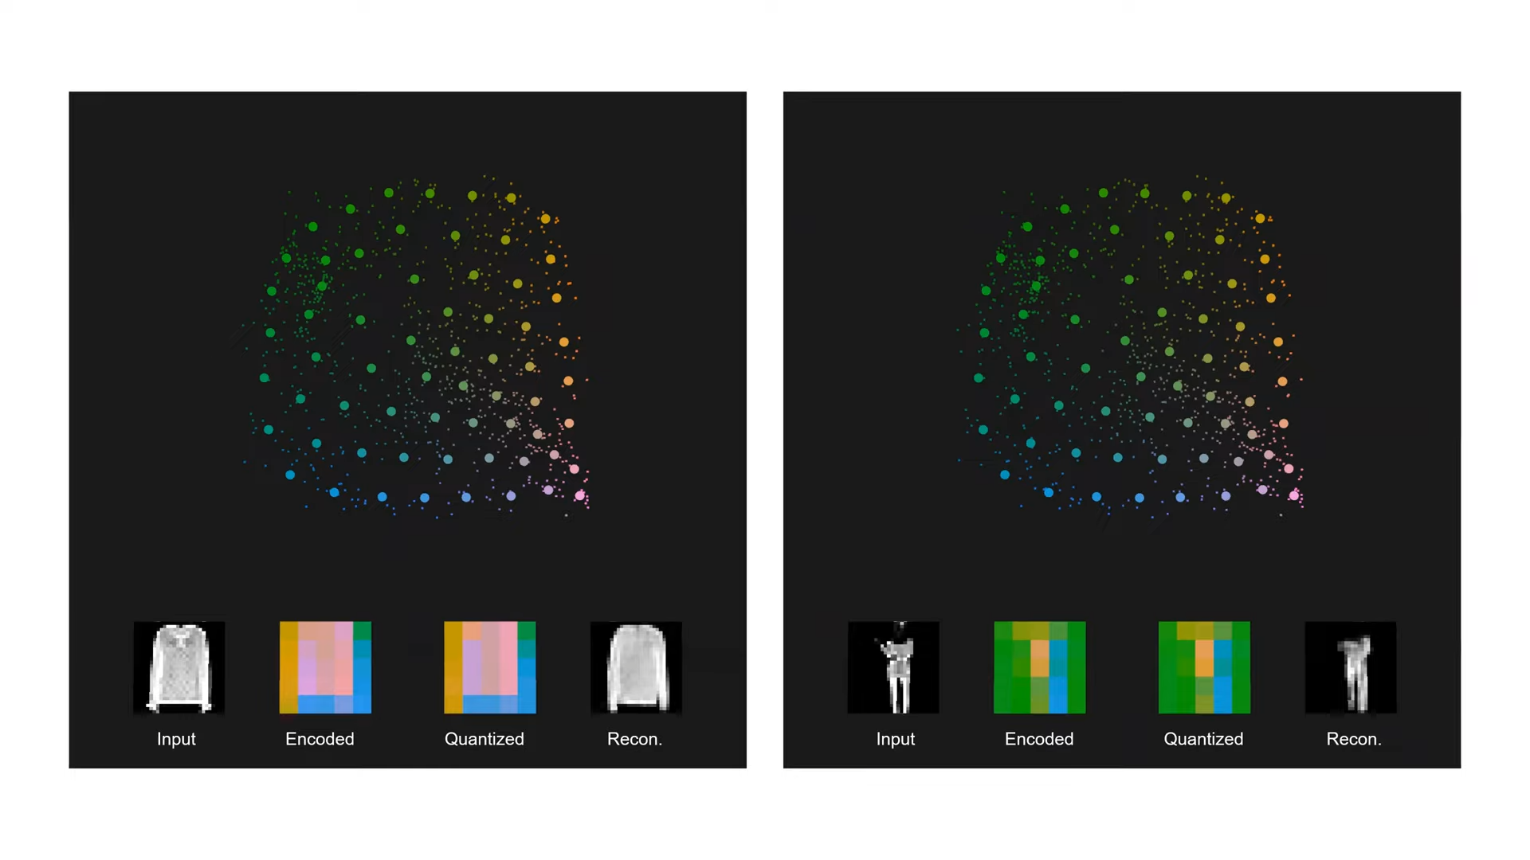
Background – VQ-VAE
Notes:
슬라이드 출처: https://www.youtube.com/watch?v=RKk17yjc1b8&list=LL&index=30

Slide 11
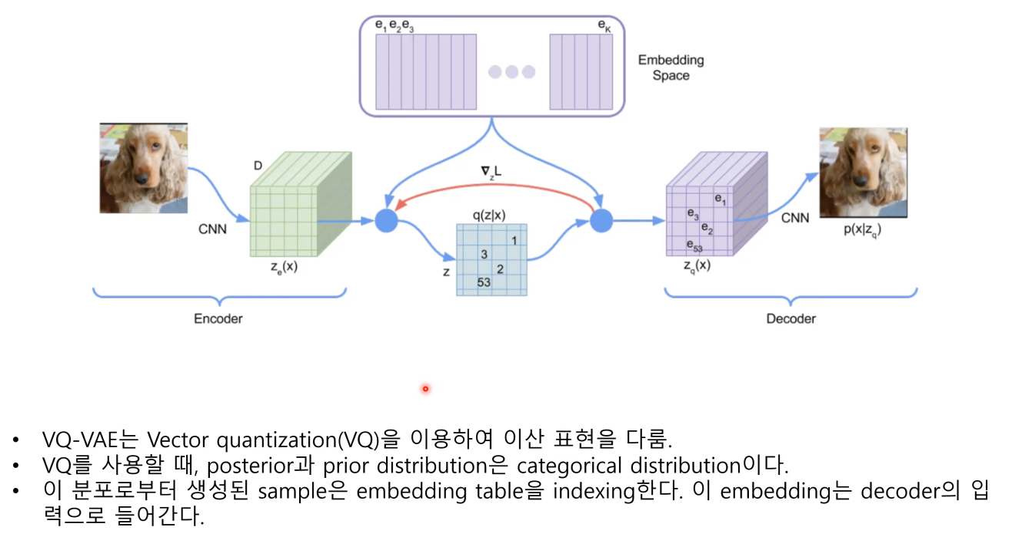
Background – VQ-VAE
Notes:
슬라이드 출처: https://www.youtube.com/watch?v=RKk17yjc1b8&list=LL&index=30

Slide 12
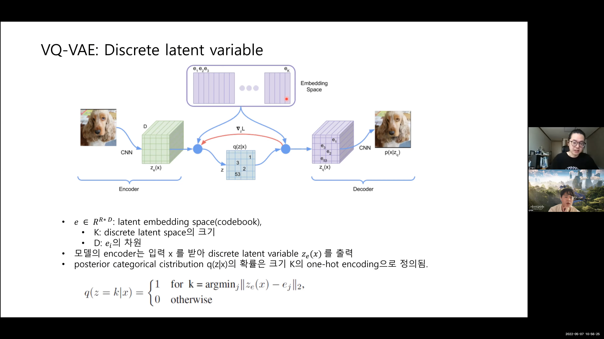
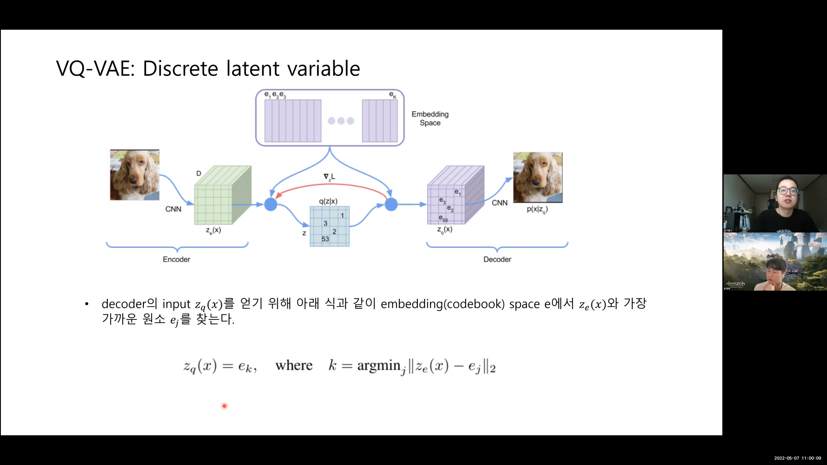
Background – VQ-VAE
Notes:
슬라이드 출처: https://www.youtube.com/watch?v=RKk17yjc1b8&list=LL&index=30

Slide 13
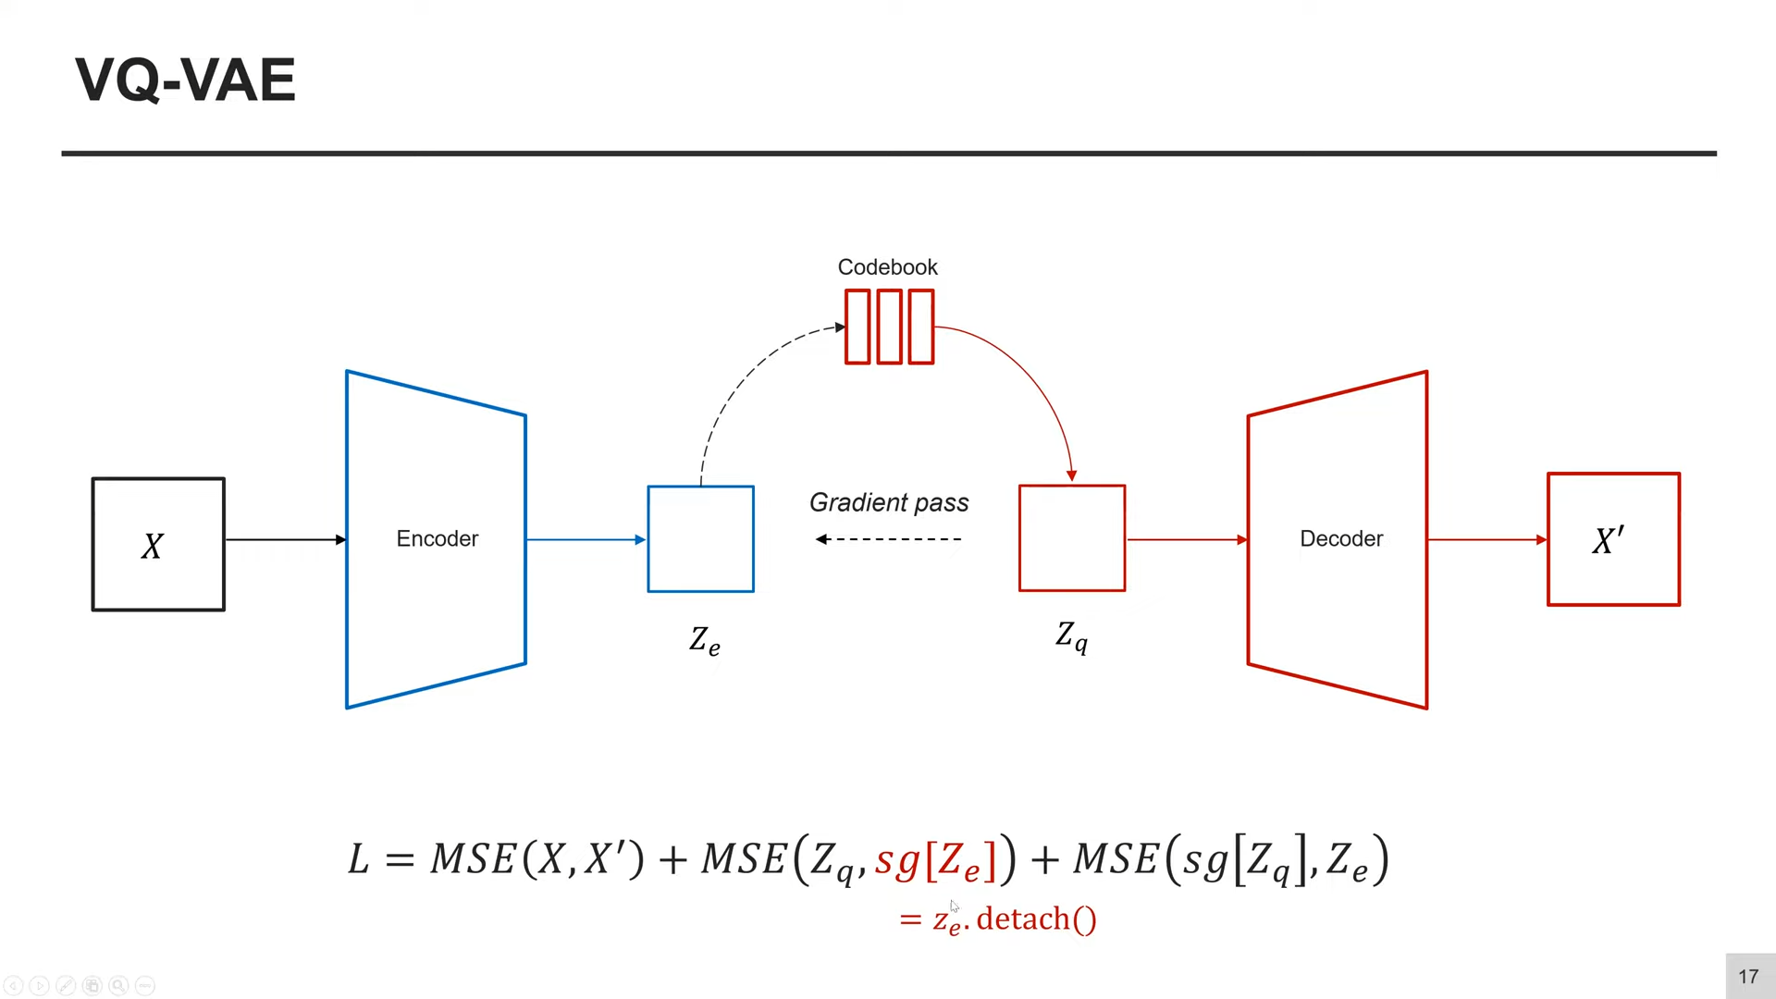
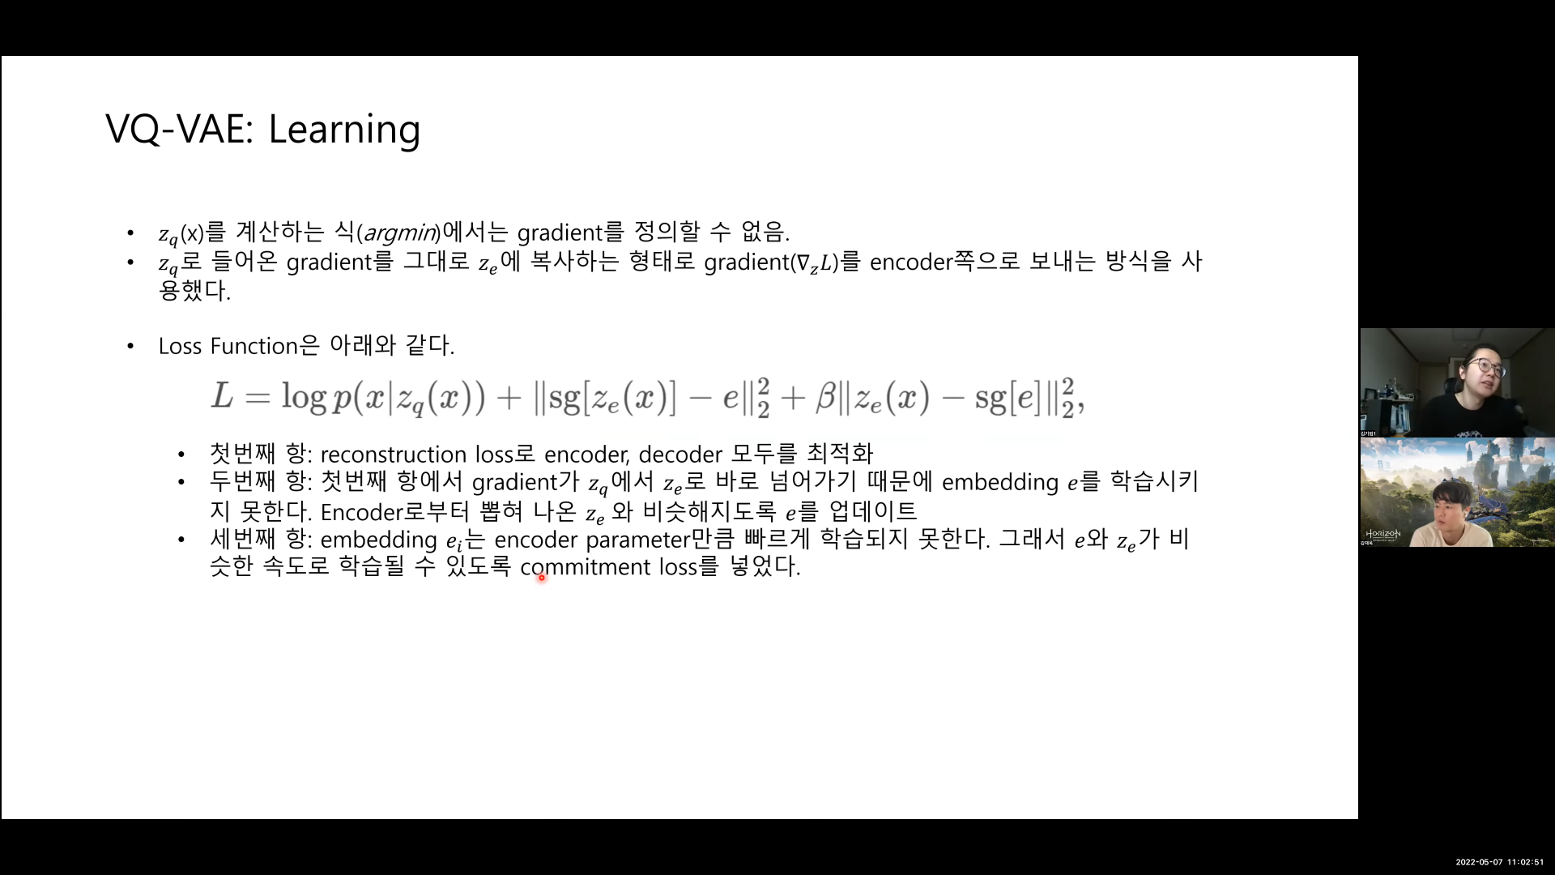
Background – VQ-VAE
Notes:
슬라이드 출처: https://www.youtube.com/watch?v=RKk17yjc1b8&list=LL&index=30

Slide 14
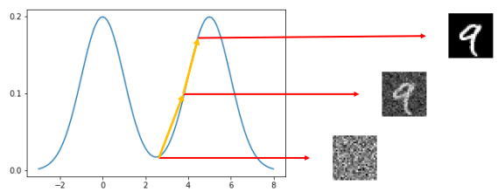
Background – DDPM
데이터 공간상에서 임의의 데이터 생성 (랜덤 노이즈)
확률밀도함수의 기울기를 계산 후 확률 값이 높아지는 방향으로 데이터 업데이트
확률 값이 높은 곳에 도달하면 샘플링 된 데이터와 유사한 데이터 생성 가능
Notes:
슬라이드 출처: https://www.youtube.com/watch?v=RKk17yjc1b8&list=LL&index=30

Slide 15
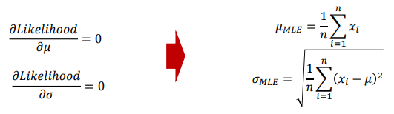
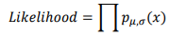
Background – DDPM
Likelihood(우도)란, 주어진 관측 값이 해당 확률분포에서 나왔을 확률, 주어진 파라미터를 이용한 분포가 모집단의 분포일 확률. 즉, 연속확률밀도함수 pdf 의 y axis 값 -> p(x).
MLE (최대 우도 추정)란, 각 관측 값에 대한 총 가능도가 최대가 되게 하는 분포를 찾는 것.
pdf 이므로 모든 sample값을 미분 계산 할 수 없으므로, 평균과 분산의 미분 값이 0이 되는 값을 찾아 MLE가 최대가 되게끔 하는 파라미터 혹은 분포를 찾는다.
Notes:
PDF이기에 모든 값을 계산 할수 없으므로, 평균과 분산의 미분값이 0이 되는 값을 찾아 MLE가 최대가 되게끔 하는 파라미터 혹은 분포를 찾는다.

Slide 16
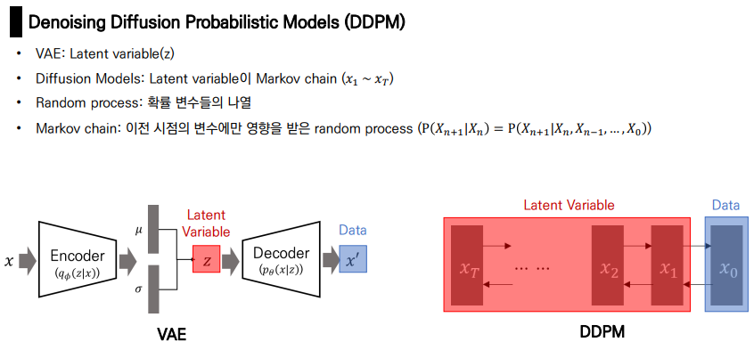
Background – DDPM
Notes:
PDF이기에 모든 값을 계산 할수 없으므로, 평균과 분산의 미분값이 0이 되는 값을 찾아 MLE가 최대가 되게끔 하는 파라미터 혹은 분포를 찾는다.

Slide 17
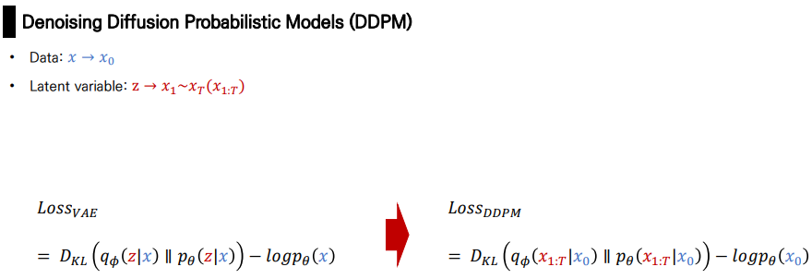
Background – DDPM
Notes:
PDF이기에 모든 값을 계산 할수 없으므로, 평균과 분산의 미분값이 0이 되는 값을 찾아 MLE가 최대가 되게끔 하는 파라미터 혹은 분포를 찾는다.

Slide 18
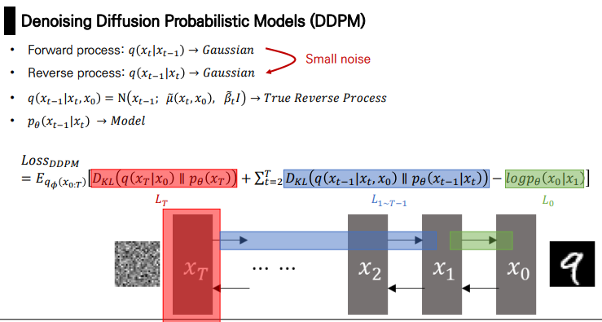
Background – DDPM
Notes:
PDF이기에 모든 값을 계산 할수 없으므로, 평균과 분산의 미분값이 0이 되는 값을 찾아 MLE가 최대가 되게끔 하는 파라미터 혹은 분포를 찾는다.

Slide 19
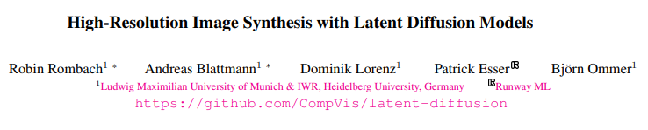
Stable Diffusion

Slide 20
Abstract
Since diffusion models typically operate directly in pixel space, optimization of powerful DMs often consumes hundreds of GPU days and inference is expensive due to sequential evaluations.
To enable DM training on limited computational resources while retaining their quality and flexibility, we apply them in the latent space of powerful pretrained autoencoders.
By introducing cross-attention layers into the model architecture, we turn diffusion models into powerful and flexible generators for general conditioning inputs (ex. Text, bounding boxes, or high-resolution synthesis becomes possible in a convolutional manner).
Our latent diffusion models (LDMs) achieve new state-of-the-art scores for image inpainting and class-conditional image synthesis, including text-to-image synthesis, unconditional image generation and super-resolution, while significantly reducing computational requirements compared to pixel-based DMs

Slide 21
Introduction
Image synthesis is a field in computer vision that has seen significant development recently but also requires a lot of computational power.
High-resolution synthesis of complex, natural scenes is typically done using likelihood-based models with billions of parameters.
GANs have shown promising results but are limited to data with less variability as their adversarial learning process does not scale well to complex, multi-modal distributions.
Recently, diffusion models, which are built from a hierarchy of denoising autoencoders, have shown to achieve impressive results in this field and are considered state-of-the-art in class-conditional image synthesis and super-resolution.
Additionally, these models do not exhibit the same issues as GANs and can model complex natural image distributions without involving billions of parameters.
“training such a model requires massive computational resources”
“evaluating an already trained model is also expensive in time and memory”
Notes:
keyword

Slide 22
Introduction
Democratizing High-Resolution Image Synthesis
DMs belong to the class of likelihood-based models, whose mode-covering behavior makes them prone to spend excessive amounts of capacity (and thus compute resources) on modeling imperceptible details of the data.
Although the reweighted variational objective aims to address this by under-sampling the initial denoising steps, DMs are still computationally demanding, since training and evaluating such a model requires repeated function evaluations (and gradient computations) in the high-dimensional space of RGB images.
“training such a model requires massive computational resources”
“evaluating an already trained model is also expensive in time and memory”
Notes:
DMs belong to the class of likelihood-based models, whose mode-covering behavior makes them prone to spend excessive amounts of capacity (and thus compute resources) on modeling imperceptible details of the data [16, 73]. Although the reweighted variational objective [30] aims to address this by undersampling the initial denoising steps, DMs are still computationally demanding, since training and evaluating such a model requires repeated function evaluations (and gradient computations) in the high-dimensional space of RGB images.

Slide 23
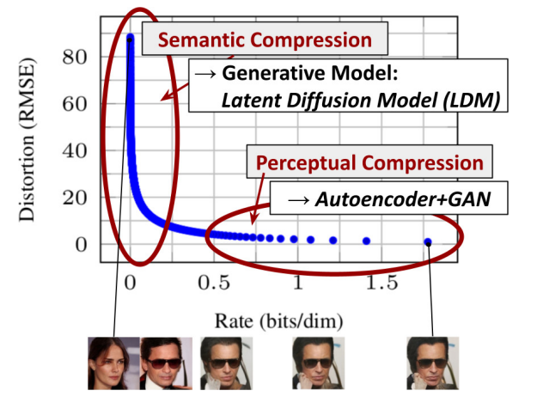
Introduction
Departure to Latent Space
As with any likelihood-based model, learning can be roughly divided into two stages:
First is a perceptual compression stage which removes high-frequency details(=imperceptible details) but still learns little semantic variation.
In the second stage, the actual generative model learns the semantic and conceptual composition of the data (semantic compression).
We thus aim to first find a perceptually equivalent, but computationally more suitable space, in which we will train diffusion models for high-resolution image synthesis.
Notes:
As with any likelihood-based model, learning can be roughly divided into two stages: First is a perceptual compression stage which removes high-frequency details but still learns little semantic variation. In the second stage, the actual generative model learns the semantic and conceptual composition of the data (semantic compression). We thus aim to first find a perceptually equivalent, but computationally more suitable space, in which we will train diffusion models for high-resolution image synthesis.

Slide 24
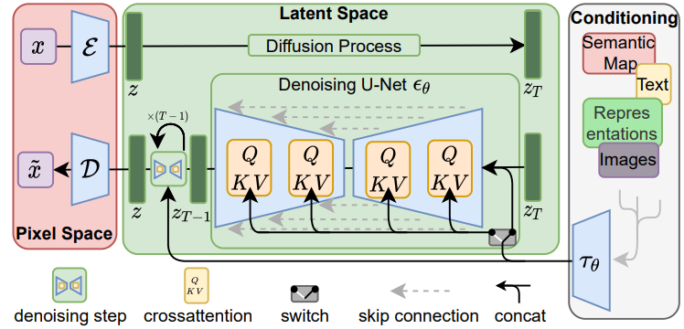
Method
Utilize an autoencoding model which learns a space that is perceptually equivalent to the image space.
(i) By leaving the high-dimensional image space, we obtain DMs which are computationally much more efficient because sampling is performed on a low-dimensional space.
(ii) We exploit the inductive bias of DMs inherited from their UNet architecture, which makes them particularly effective for data with spatial structure and therefore alleviates the need for aggressive, quality-reducing compression levels as required by previous approaches.
(iii) Finally, we obtain general-purpose compression models whose latent space can be used to train multiple generative models and which can also be utilized for other downstream applications

Slide 25
Method
Perceptual Image Compression
Our perceptual compression model is based on previous work and consists of an autoencoder trained by combination of a perceptual loss and a patch-based adversarial objective.
This ensures that the reconstructions are confined to the image manifold by enforcing local realism and avoids bluriness introduced by relying solely on pixel-space losses
the encoder E encodes x into a latent representation z = E(x), and the decoder D reconstructs the image from the latent, giving x˜ = D(z) = D(E(x)), where z ∈ R^{h×w×c}
Importantly, the encoder downsamples the image by a factor f = H/h = W/w, and we investigate different downsampling factors f = 2^{m}, with m ∈ N.
KL-reg, VQ-reg

Slide 26
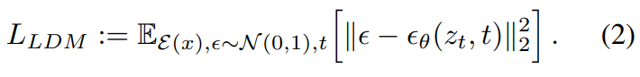
Method
Generative Modeling of Latent Representations
We now have access to an efficient, low-dimensional latent space in which high-frequency, imperceptible details are abstracted away.
Compared to the high-dimensional pixel space, this space is more suitable for likelihood-based generative models, as they can now (i) focus on the important, semantic bits of the data and (ii) train in a lower dimensional, computationally much more efficient space
the ability to build the underlying UNet primarily from 2D convolutional layers, and further focusing the objective on the perceptually most relevant bits using the reweighted bound, which now reads the neural backbone E_{θ}(◦, t) of our model is realized as a time-conditional UNet
Notes:
Compared to the high-dimensional pixel space, this space is more suitable for likelihood-based generative models, as they can now (i) focus on the important, semantic bits of the data and (ii) train in a lower dimensional, computationally much more efficient space

Slide 27
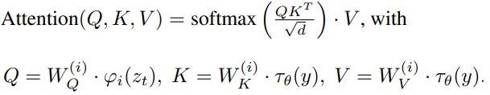
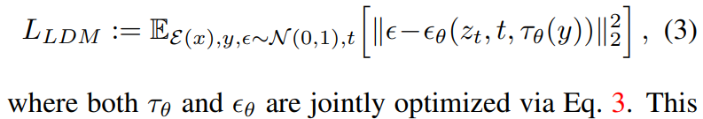
Method
Conditioning Mechanisms
This can be implemented with a conditional denoising autoencoder θ(zt, t, y) and paves the way to controlling the synthesis process through inputs y such as text [68], semantic maps [33, 61] or other image-to-image translation tasks [34].
We turn DMs into more flexible conditional image generators by augmenting their underlying UNet backbone with the cross-attention mechanism
we introduce a domain specific encoder τθ that projects y to an intermediate representation τ_{θ}(y) ∈ R^{M×dτ} , which is then mapped to the intermediate layers of the UNet via a cross-attention layer
Notes:
We turn DMs into more flexible conditional image generators by augmenting their underlying UNet backbone with the cross-attention mechanism

Slide 28
Experiments
Quantitative Results in Unconditional and Class-Conditional Image Synthesis
the FID-, Precision- and Recall-scores (torch-fidelity package)
50k samples from our models and the entire training set of each of the shown datasets
Text-to-Image Synthesis
FID and Inception Score (torch-fidelity package)
30000 samples from the validation set of the MS-COCO dataset
Layout-to-Image Synthesis
FID score (torch-fidelity package)
we similarly follow their protocol and use 2048 center-cropped test images from the validation set.
Super Resolution
FID score (torch-fidelity package)
images with a shorter size less than 256 px are removed, the low-resolution images are produced using bicubic interpolation with anti-aliasing.
User Study
’Which of the two images is a better high quality version of the low resolution image in the middle?’
’Which of the two images contains more realistic inpainted regions of the image in the middle?’
Notes:
’Which of the two images contains more realistic inpainted regions of the image in the middle?’

Slide 29
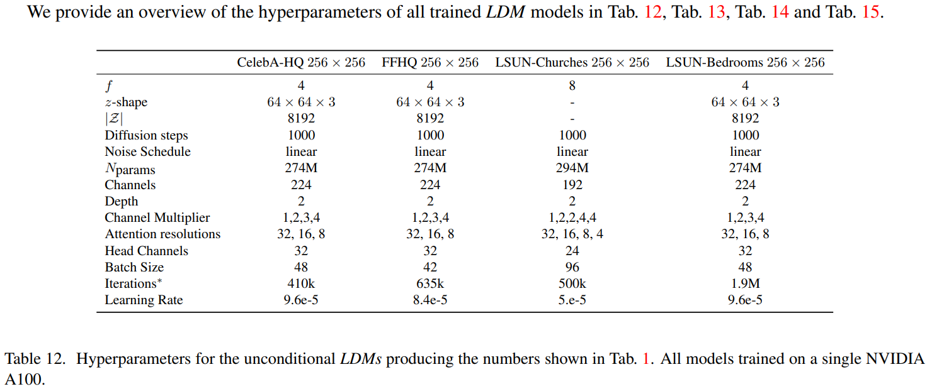
Experiments
Hyperparameters
Notes:
Hyperparameters

Slide 30
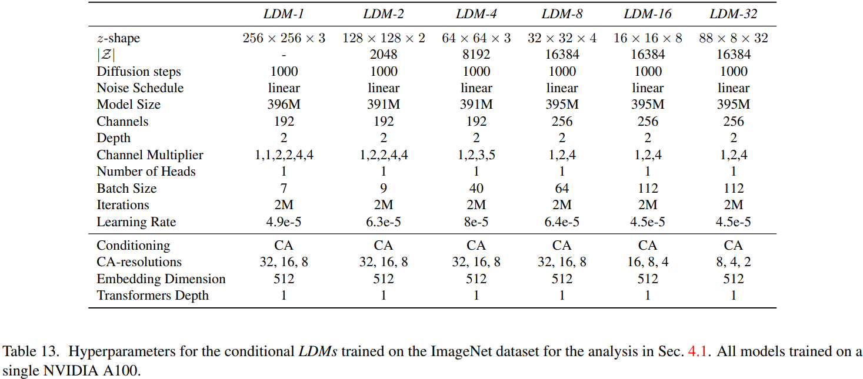
Experiments
Hyperparameters
Notes:
VAE:
VAE, VQ-VAE, VQ-VAE-2, Continuous relaxation
Diffusion:
NCNS, DDPM, DDIM, ADM
Multi-Modal:
DALL-E, DALL-E-2, GLIDE, Stable Diffusion

Slide 31
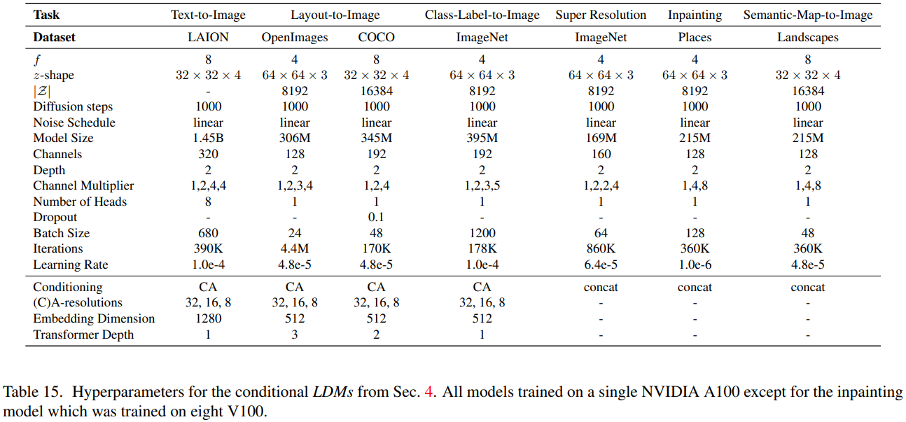
Experiments
Hyperparameters
Notes:
VAE:
VAE, VQ-VAE, VQ-VAE-2, Continuous relaxation
Diffusion:
NCNS, DDPM, DDIM, ADM
Multi-Modal:
DALL-E, DALL-E-2, GLIDE, Stable Diffusion

Slide 32
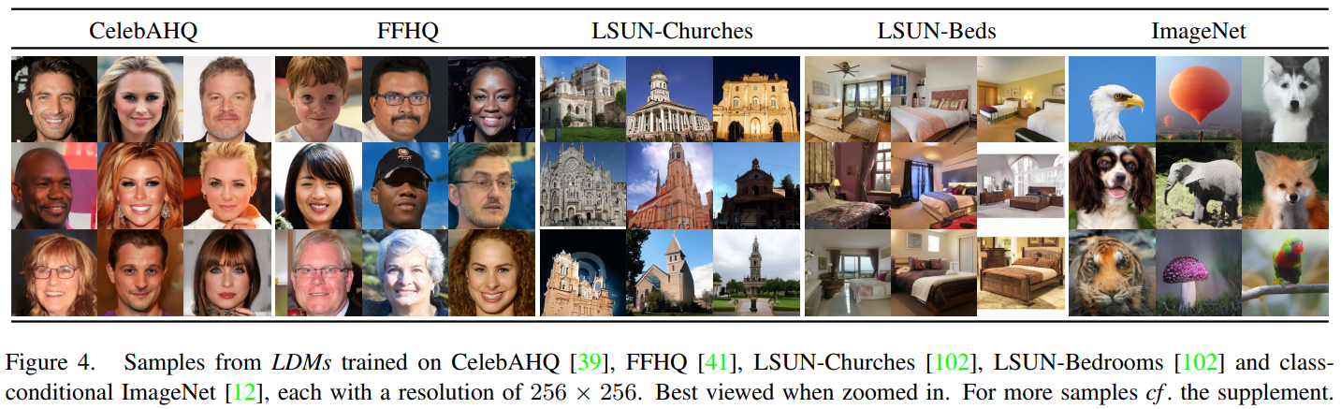
Experiments
Notes:
VAE:
VAE, VQ-VAE, VQ-VAE-2, Continuous relaxation
Diffusion:
NCNS, DDPM, DDIM, ADM
Multi-Modal:
DALL-E, DALL-E-2, GLIDE, Stable Diffusion

Slide 33
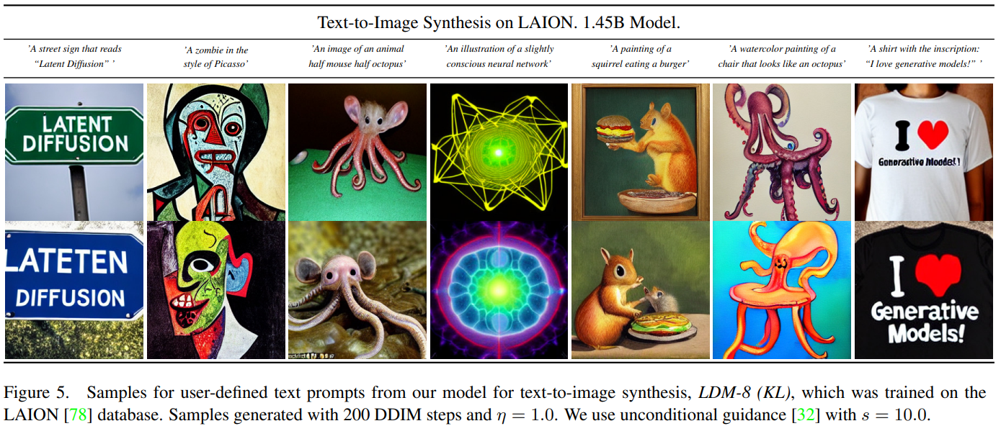
Experiments
Notes:
VAE:
VAE, VQ-VAE, VQ-VAE-2, Continuous relaxation
Diffusion:
NCNS, DDPM, DDIM, ADM
Multi-Modal:
DALL-E, DALL-E-2, GLIDE, Stable Diffusion

Slide 34
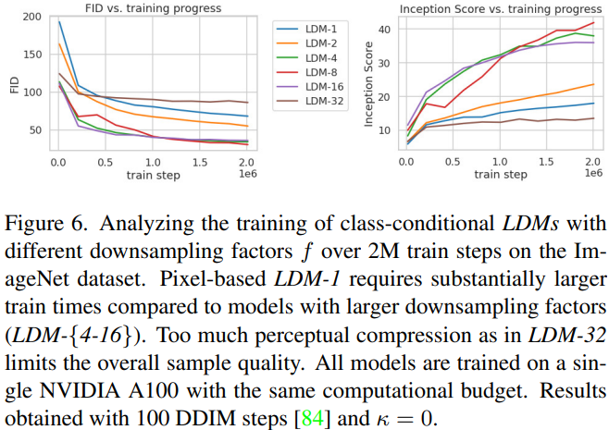
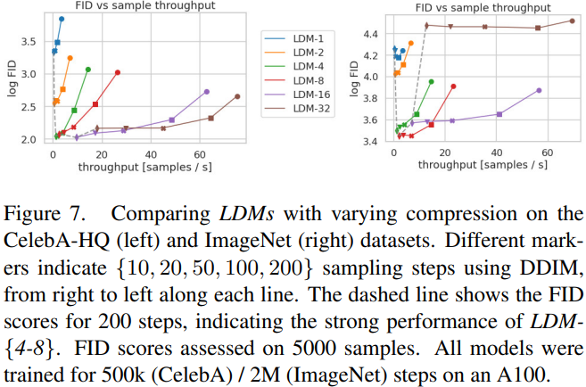
Experiments
Notes:
VAE:
VAE, VQ-VAE, VQ-VAE-2, Continuous relaxation
Diffusion:
NCNS, DDPM, DDIM, ADM
Multi-Modal:
DALL-E, DALL-E-2, GLIDE, Stable Diffusion

Slide 35
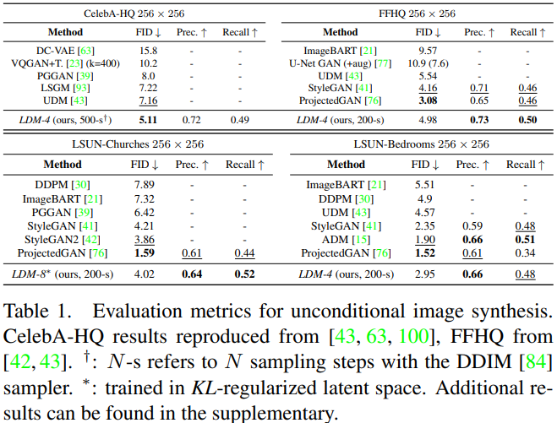
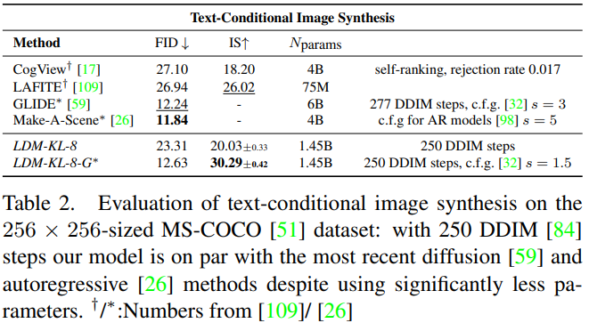
Experiments
Notes:
VAE:
VAE, VQ-VAE, VQ-VAE-2, Continuous relaxation
Diffusion:
NCNS, DDPM, DDIM, ADM
Multi-Modal:
DALL-E, DALL-E-2, GLIDE, Stable Diffusion

Slide 36
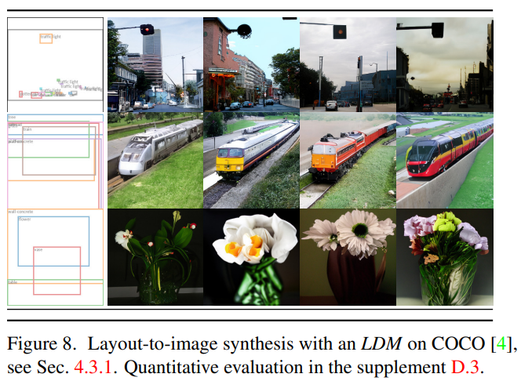
Experiments
Notes:
VAE:
VAE, VQ-VAE, VQ-VAE-2, Continuous relaxation
Diffusion:
NCNS, DDPM, DDIM, ADM
Multi-Modal:
DALL-E, DALL-E-2, GLIDE, Stable Diffusion

Slide 37
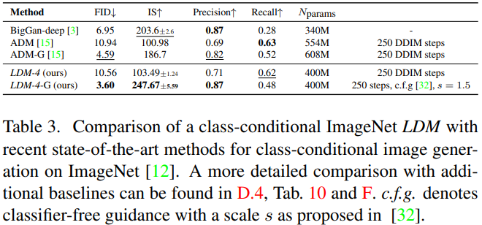
Experiments
Notes:
VAE:
VAE, VQ-VAE, VQ-VAE-2, Continuous relaxation
Diffusion:
NCNS, DDPM, DDIM, ADM
Multi-Modal:
DALL-E, DALL-E-2, GLIDE, Stable Diffusion

Slide 38
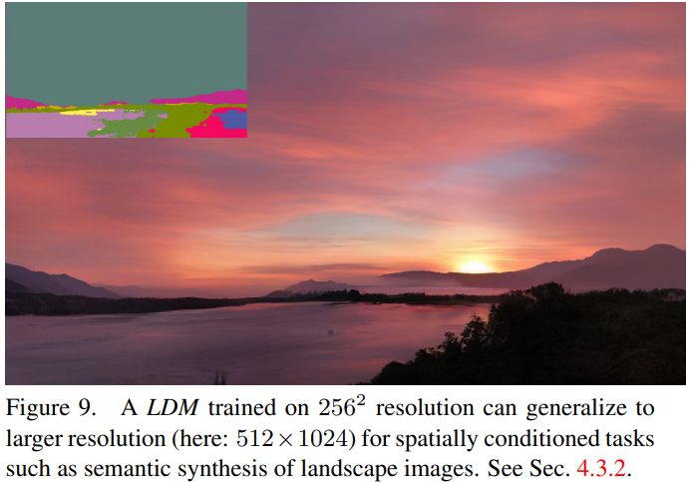
Experiments
Notes:
VAE:
VAE, VQ-VAE, VQ-VAE-2, Continuous relaxation
Diffusion:
NCNS, DDPM, DDIM, ADM
Multi-Modal:
DALL-E, DALL-E-2, GLIDE, Stable Diffusion

Slide 39
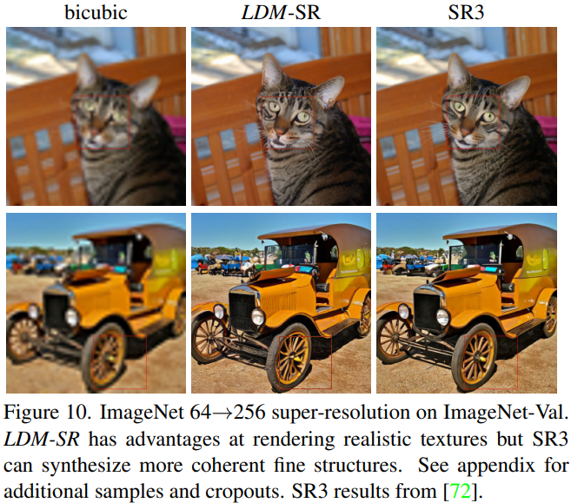
Experiments
Notes:
VAE:
VAE, VQ-VAE, VQ-VAE-2, Continuous relaxation
Diffusion:
NCNS, DDPM, DDIM, ADM
Multi-Modal:
DALL-E, DALL-E-2, GLIDE, Stable Diffusion

Slide 40
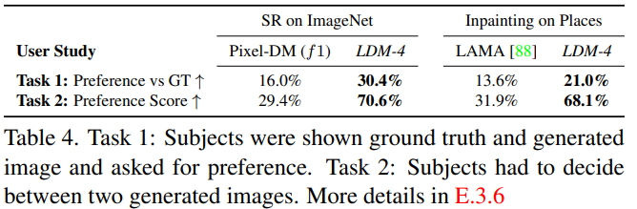
Experiments
Notes:
VAE:
VAE, VQ-VAE, VQ-VAE-2, Continuous relaxation
Diffusion:
NCNS, DDPM, DDIM, ADM
Multi-Modal:
DALL-E, DALL-E-2, GLIDE, Stable Diffusion

Slide 41
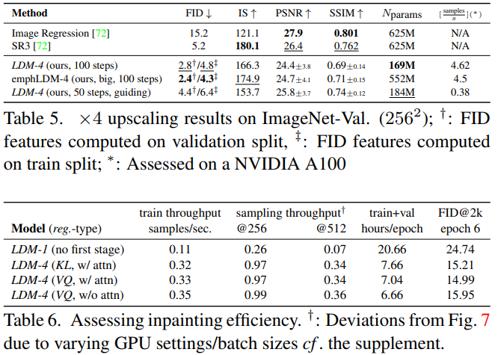
Experiments
Notes:
VAE:
VAE, VQ-VAE, VQ-VAE-2, Continuous relaxation
Diffusion:
NCNS, DDPM, DDIM, ADM
Multi-Modal:
DALL-E, DALL-E-2, GLIDE, Stable Diffusion

Slide 42
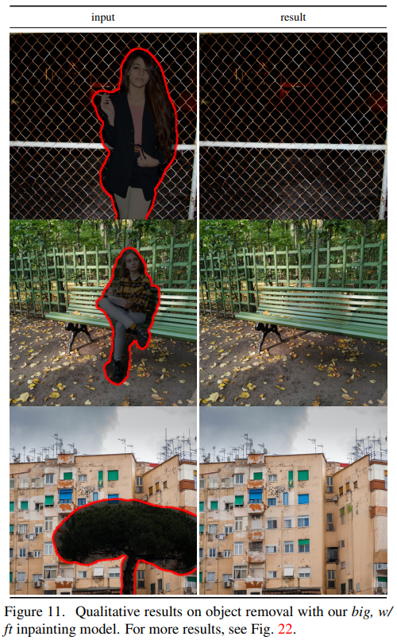
Experiments

Slide 43
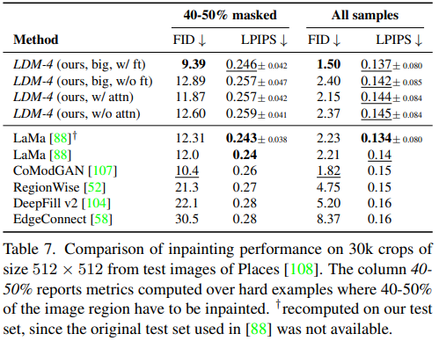
Experiments

Slide 44
Limitation
Limitations
While LDMs significantly reduce computational requirements compared to pixel-based approaches, their sequential sampling process is still slower than that of GANs.
Moreover, the use of LDMs can be questionable when high precision is required: although the loss of image quality is very small in our f=4 autoencoding models, their reconstruction capability can become a bottleneck for tasks that require fine-grained accuracy in pixel space.
Societal Impact
Generative models for media like imagery are a double-edged sword: On the one hand, they enable various creative applications, and in particular approaches like ours that reduce the cost of training and inference have the potential to facilitate access to this technology and democratize its exploration.
On the other hand, it also means that it becomes easier to create and disseminate manipulated data or spread misinformation and spam. In particular, the deliberate manipulation of images (“deep fakes”) is a common problem in this context, and women in particular are disproportionately affected by it.
Generative models can also reveal their training data, which is of great concern when the data contain sensitive or personal information and were collected without explicit consent.

Slide 45
Conclusion
We have presented latent diffusion models, a simple and efficient way to significantly improve both the training and sampling efficiency of denoising diffusion models without degrading their quality.
Based on this and our cross-attention conditioning mechanism, our experiments could demonstrate favorable results compared to state-of-the-art methods across a wide range of conditional image synthesis tasks without task-specific architectures.

Slide 46
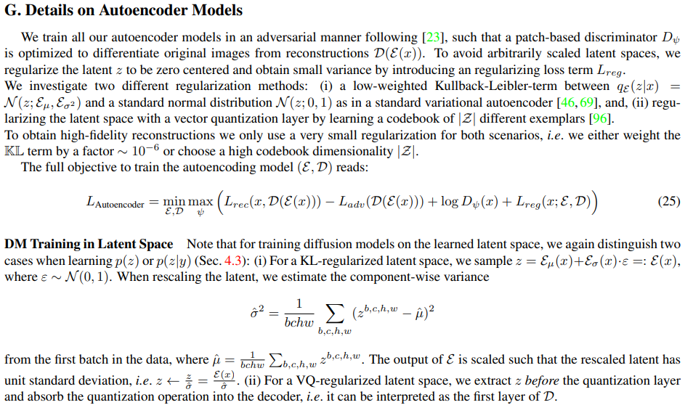
Appendix

Slide 47
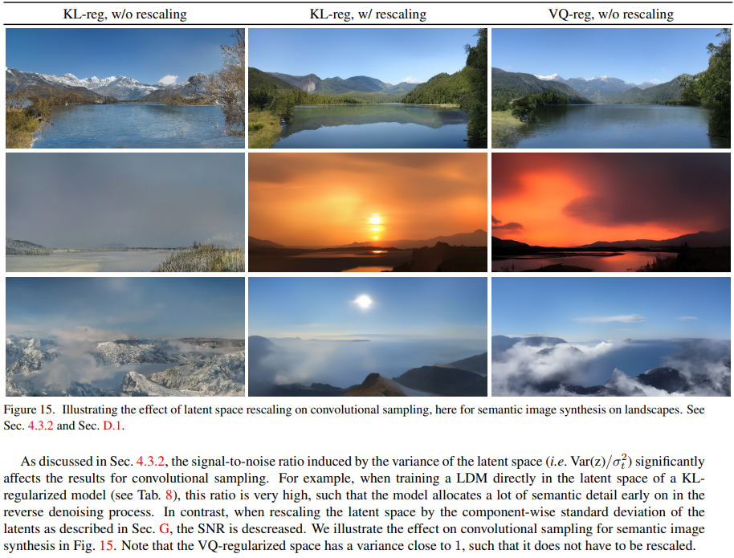
Appendix

Slide 48
Reference
https://arxiv.org/abs/2208.05140
CLIP: http://dmqm.korea.ac.kr/activity/seminar/365
Score-based Generative Models and Diffusion Models : http://dmqm.korea.ac.kr/activity/seminar/352
Multimodal Learning: http://dmqm.korea.ac.kr/activity/seminar/341
Multimodal Representation Learning :
How to narrow heterogeneity gap: http://dmqm.korea.ac.kr/activity/seminar/373
Denoising Diffusion Probabilistic Models: https://www.youtube.com/watch?v=_JQSMhqXw-4
DiffusionCLIP: https://www.youtube.com/watch?v=ZKAXgg_OAE0
VATT: https://www.youtube.com/watch?v=rgXxAFIBido
ImageBART: https://www.youtube.com/watch?v=uy3MEwBTR4o
NÜWA: https://www.youtube.com/watch?v=jDlLnNiRXTc
data2vec: https://www.youtube.com/watch?v=cFPCKCglpuE
DALL-E 1: https://www.youtube.com/watch?v=az-OV47oKvA
DALL-E 2: https://www.youtube.com/watch?v=WRkClaOAjkA
Retrieval-Augmented Diffusion Models: https://www.youtube.com/watch?v=Ktgt7bcXLYI
Structured Denoising Diffusion Models in Discrete State-Spaces: https://www.youtube.com/watch?v=kZz4HLLS-q0
Score-based Generative Modeling Through Stochastic Differential Equations: https://www.youtube.com/watch?v=uG2ceFnUeQU
Denoising Diffusion Probabilistic Models: https://www.youtube.com/watch?v=1j0W_lu55nc&t=24s
GLIDE: https://www.youtube.com/watch?v=ajBRo40-Kjs, https://www.youtube.com/watch?v=Ntjm2Icrh0E
Diffusion Model 설명: https://www.youtube.com/watch?v=uFoGaIVHfoE
Stable Diffusion: https://www.youtube.com/watch?v=ibB6aR9xA1Q
DDPM 소개 블로그 (유명): https://angusturner.github.io/generative_models/2021/06/29/diffusion-probabilistic-models-I.html
DDPM + 총망라 블로그 (유명): https://lilianweng.github.io/posts/2021-07-11-diffusion-models/
유재준 교수님: https://www.youtube.com/watch?v=m0sehjymZNU
조한샘: https://www.youtube.com/watch?v=ix09cEMmwb0

Slide 49



Thank you for your Attention….!
Notes:
The key insight of our model is to learn such representations by predicting the future in latent space by using powerful autoregressive models

